Slide 1
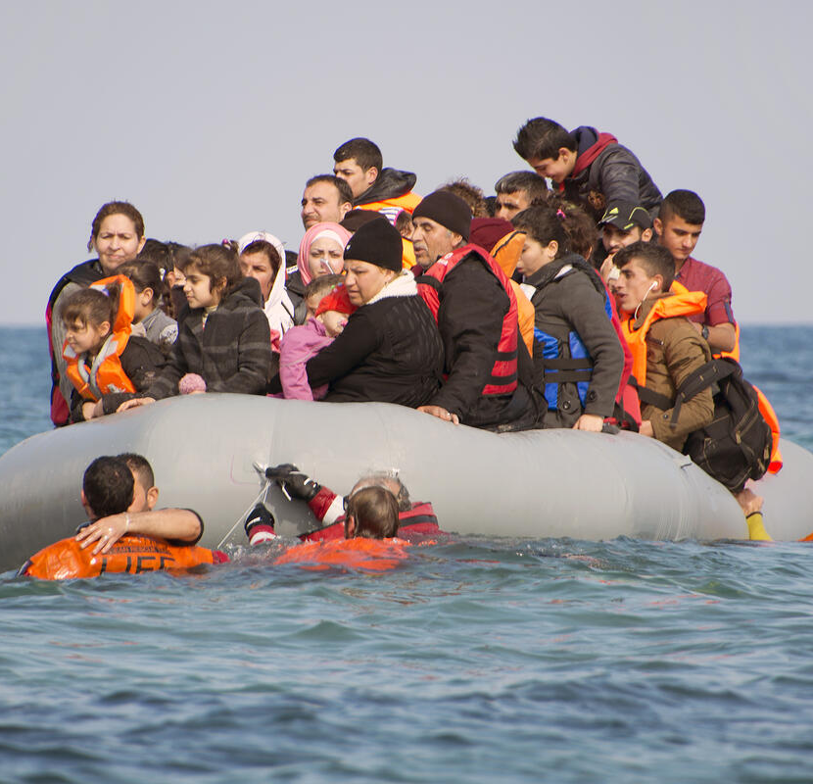
EU REFUGEE DISTRIBUTION ANALYSIS
by Ashraful Firoz & Gaia Castelpietra

Slide 2
OUR QUESTION

Slide 3

Is the distribution of refugees across the European Union balanced?
1) Is the refugee's distribution affected by the host country's distance to the refugee's origin country?
2) Is the refugee's distribution affected by the host country's wealth?

Slide 4
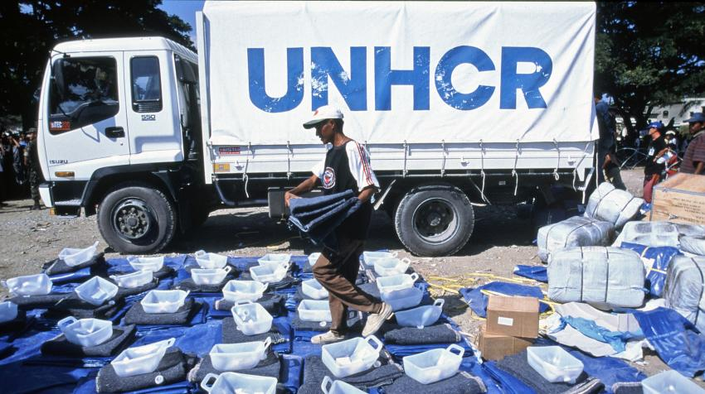
THE DATASET
“The Office of the United Nations High Commissioner for Refugees (UNHCR) is a United Nations agency mandated to aid and protect refugees, forcibly displaced communities, and stateless people, and to assist in their voluntary repatriation, local integration or resettlement to a third country.”

Slide 5
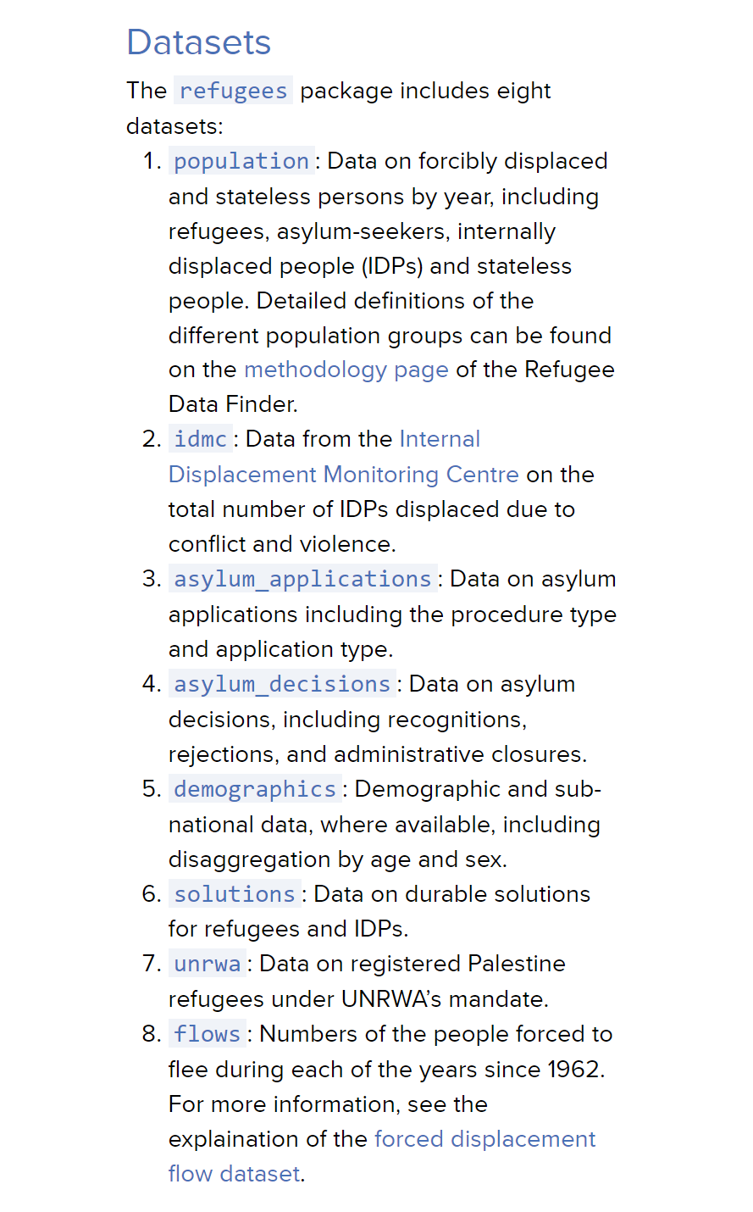
“REFUGEES” R PACKAGE
“UNHCR has created the refugees R package designed to facilitate access to the data within the Refugee Data Finder.”

Slide 6

RESOURCES
https://en.wikipedia.org/wiki/United_Nations_High_Commissioner_for_Refugees
https://www.unhcr.org/refugee-statistics/insights/explainers/refugees-r-package.html
https://cran.r-project.org/web/packages/refugees/refugees.pdf

Slide 7
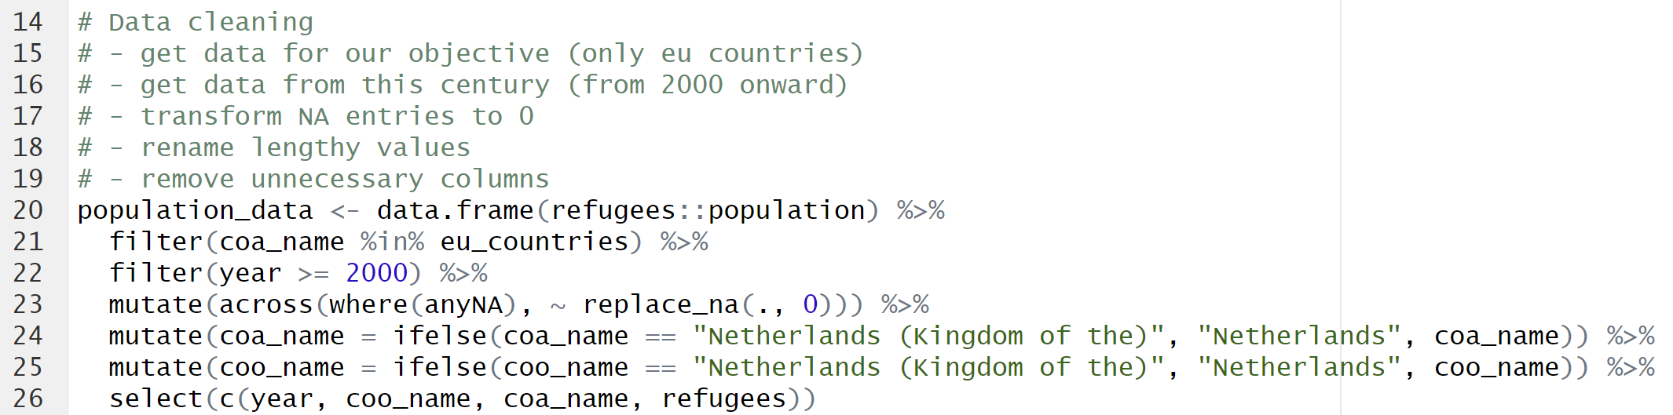
DATA CLEANING

Slide 8
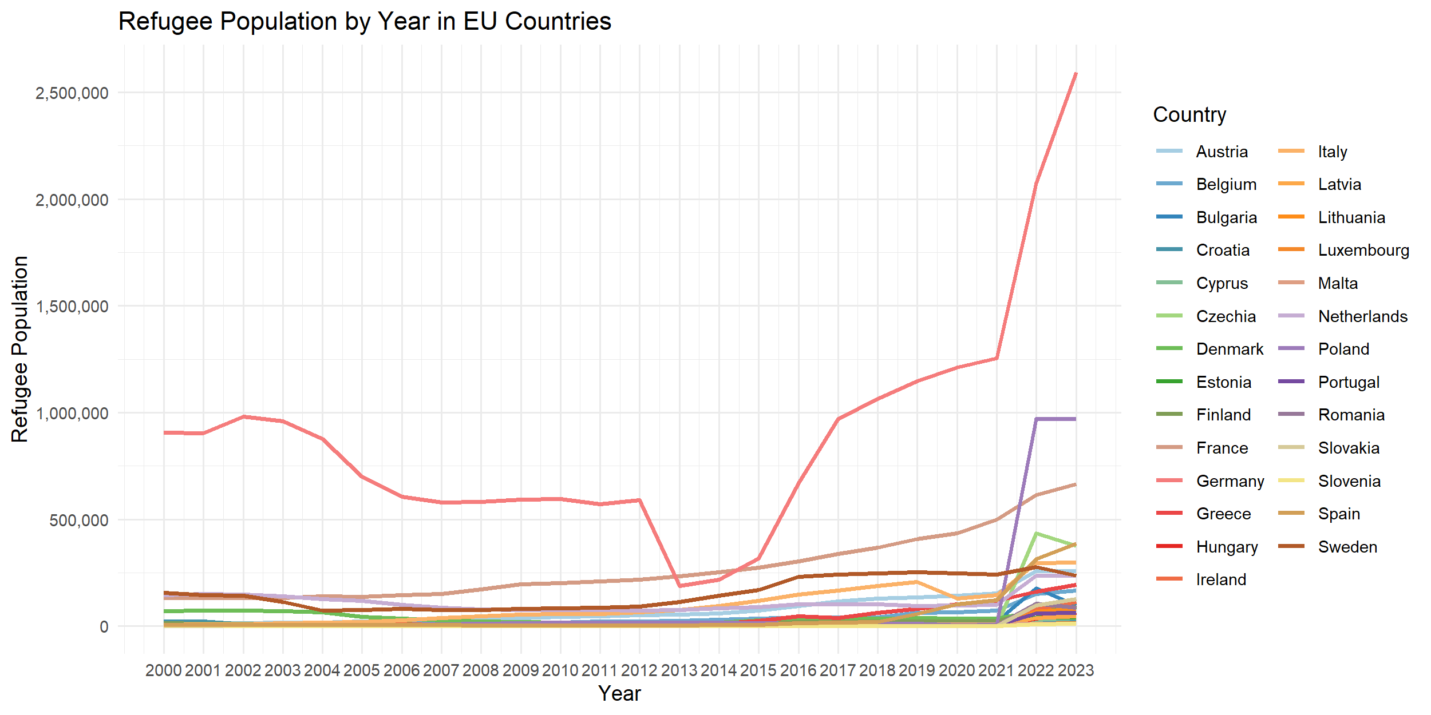
REFUGEE POPULATION IN THE YEARS

Slide 9
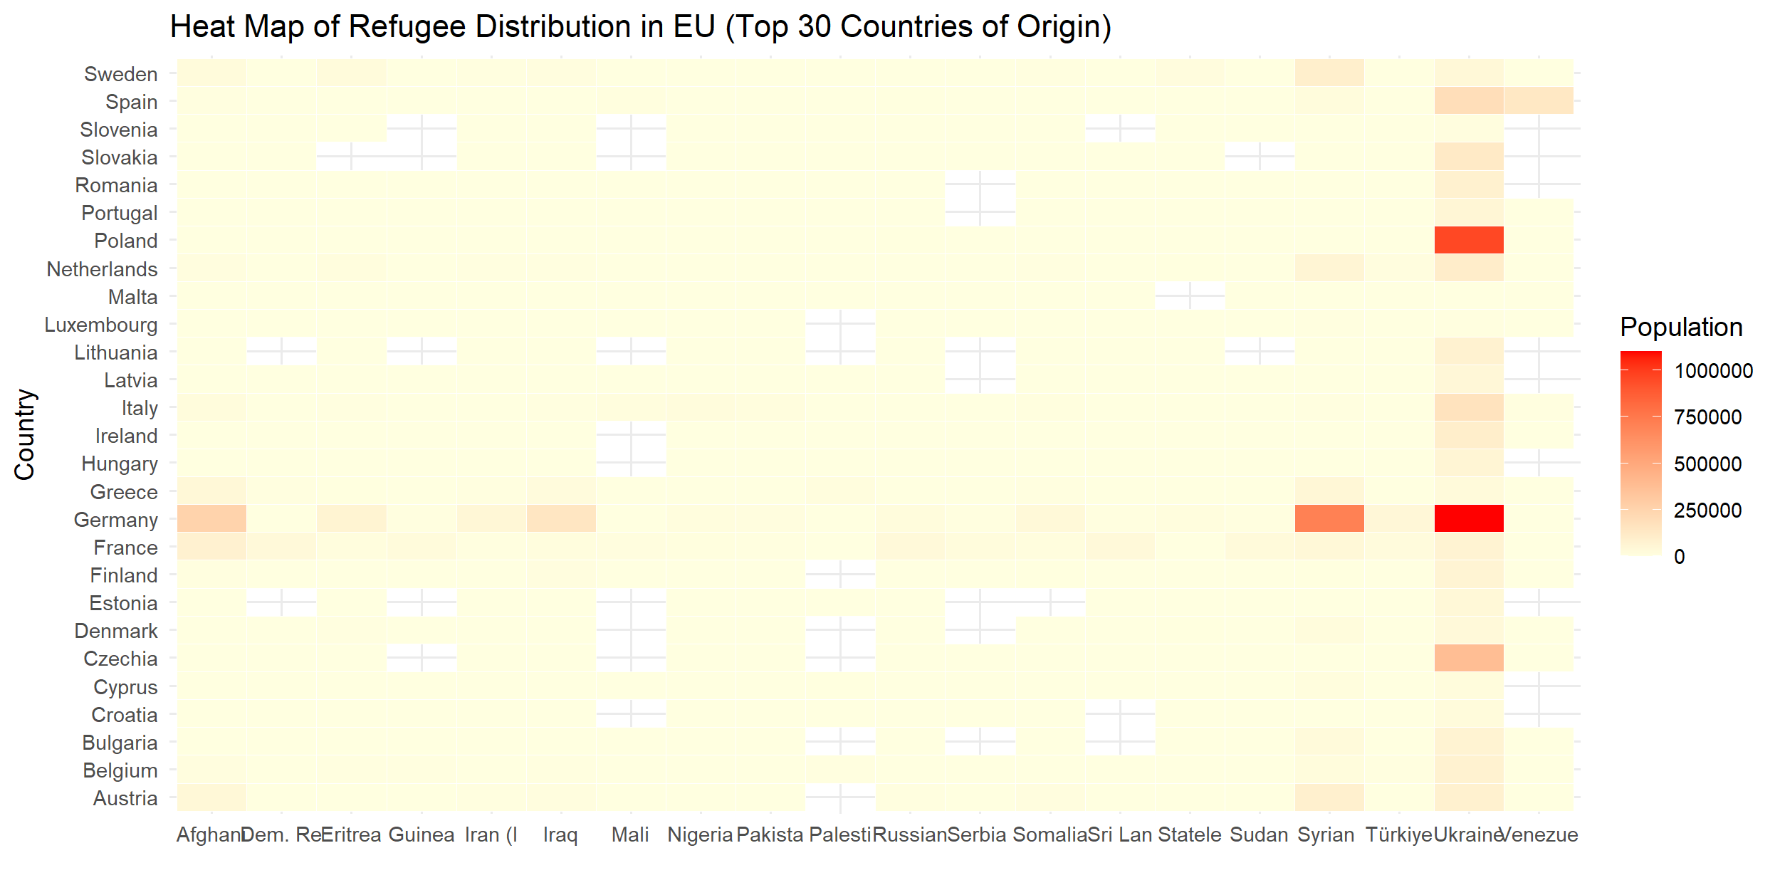
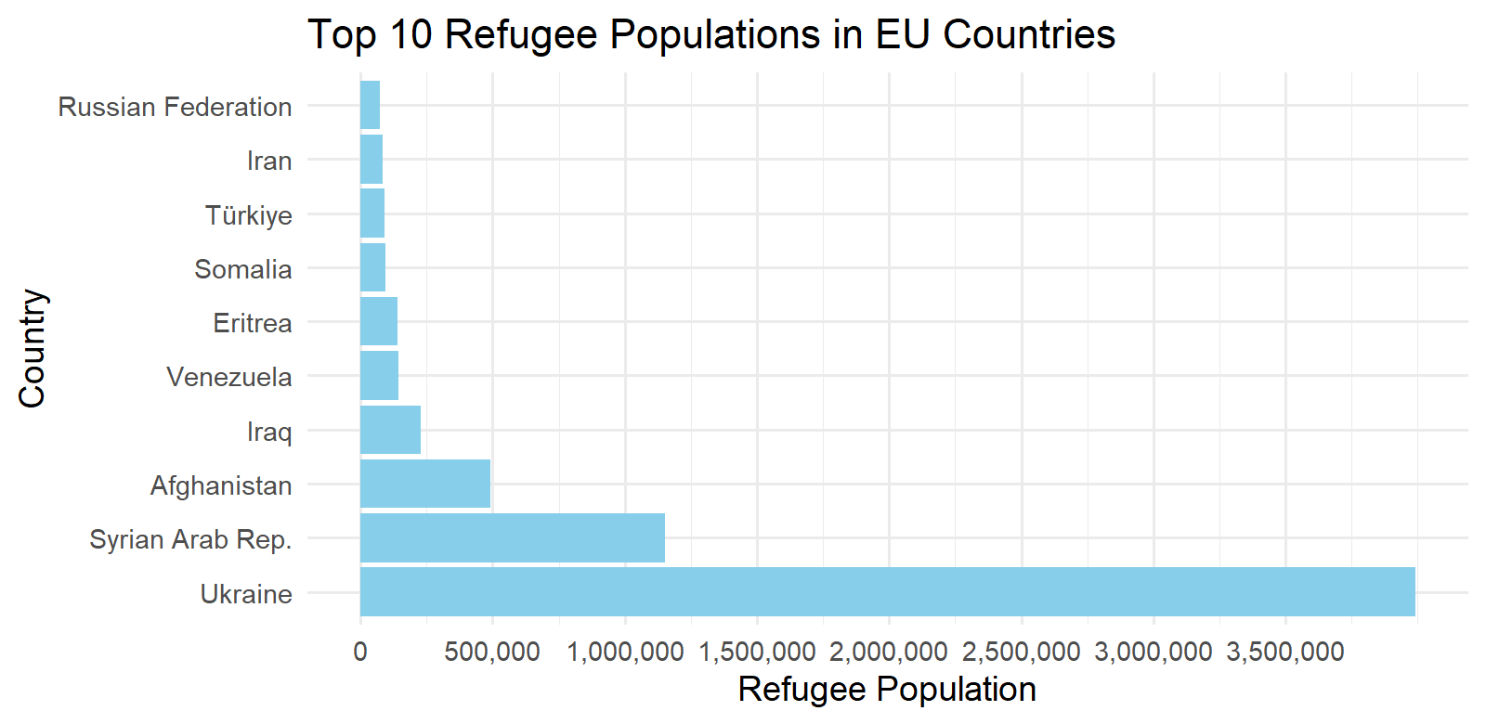
REFUGEE COUNTRIES OF ORIGIN

Slide 10
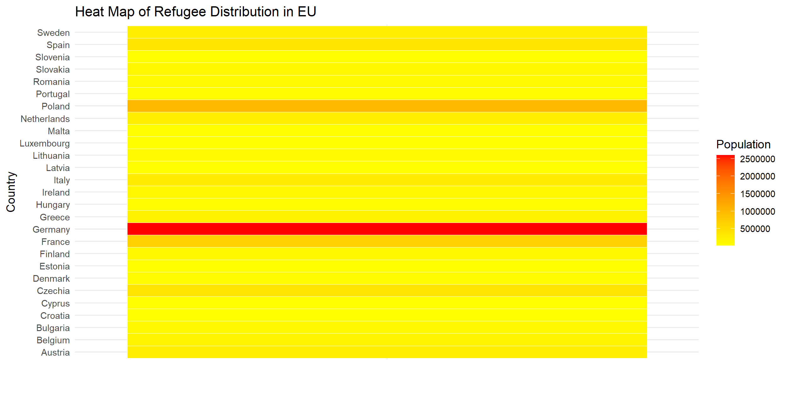
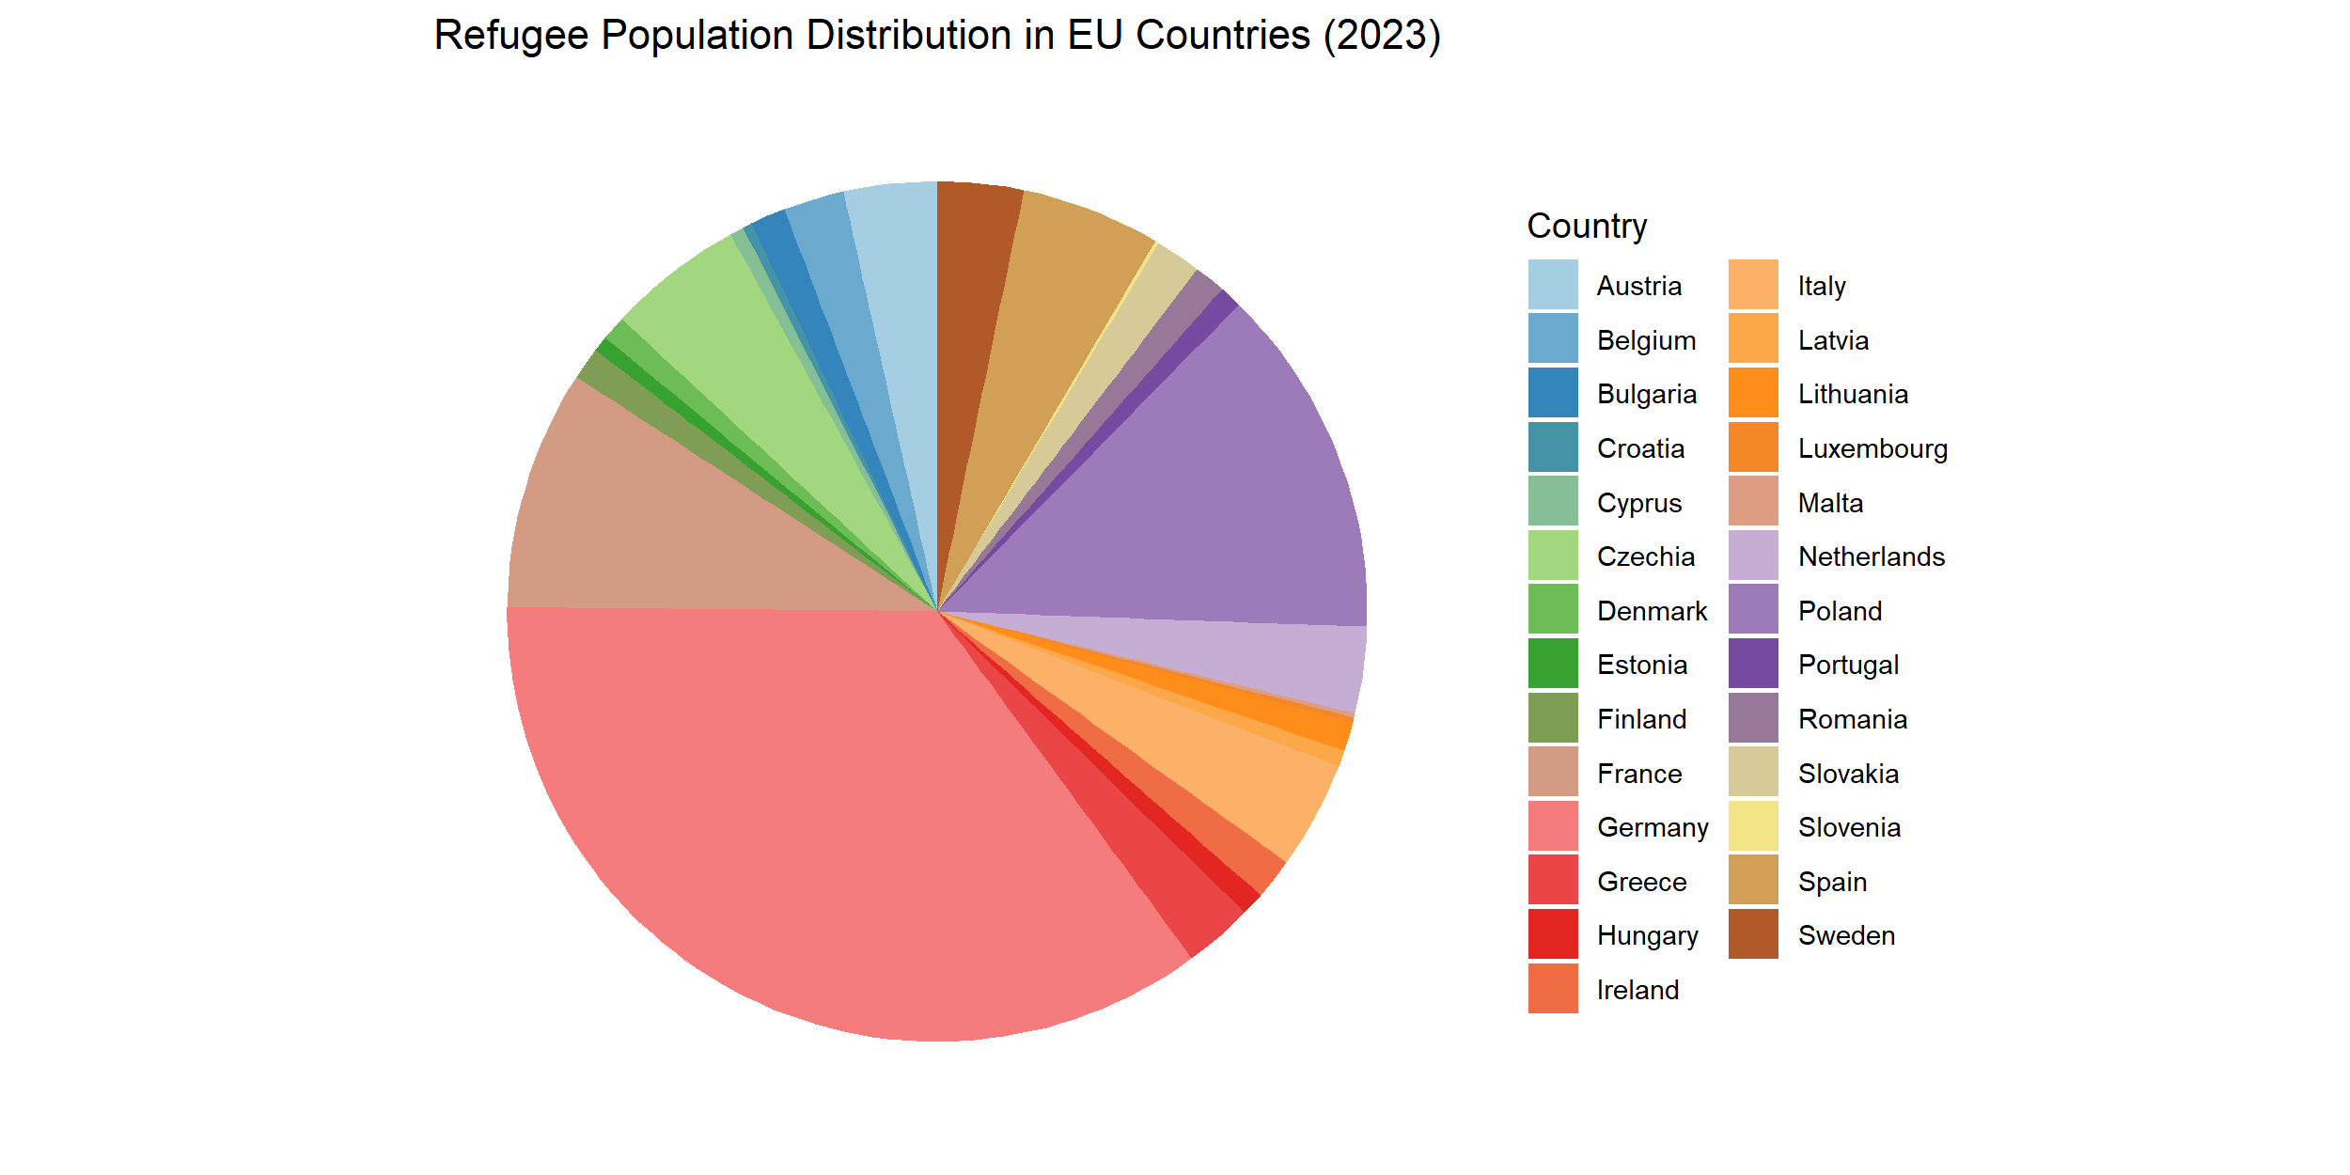
REFUGEE POPULATION DISTRIBUTION

Slide 11
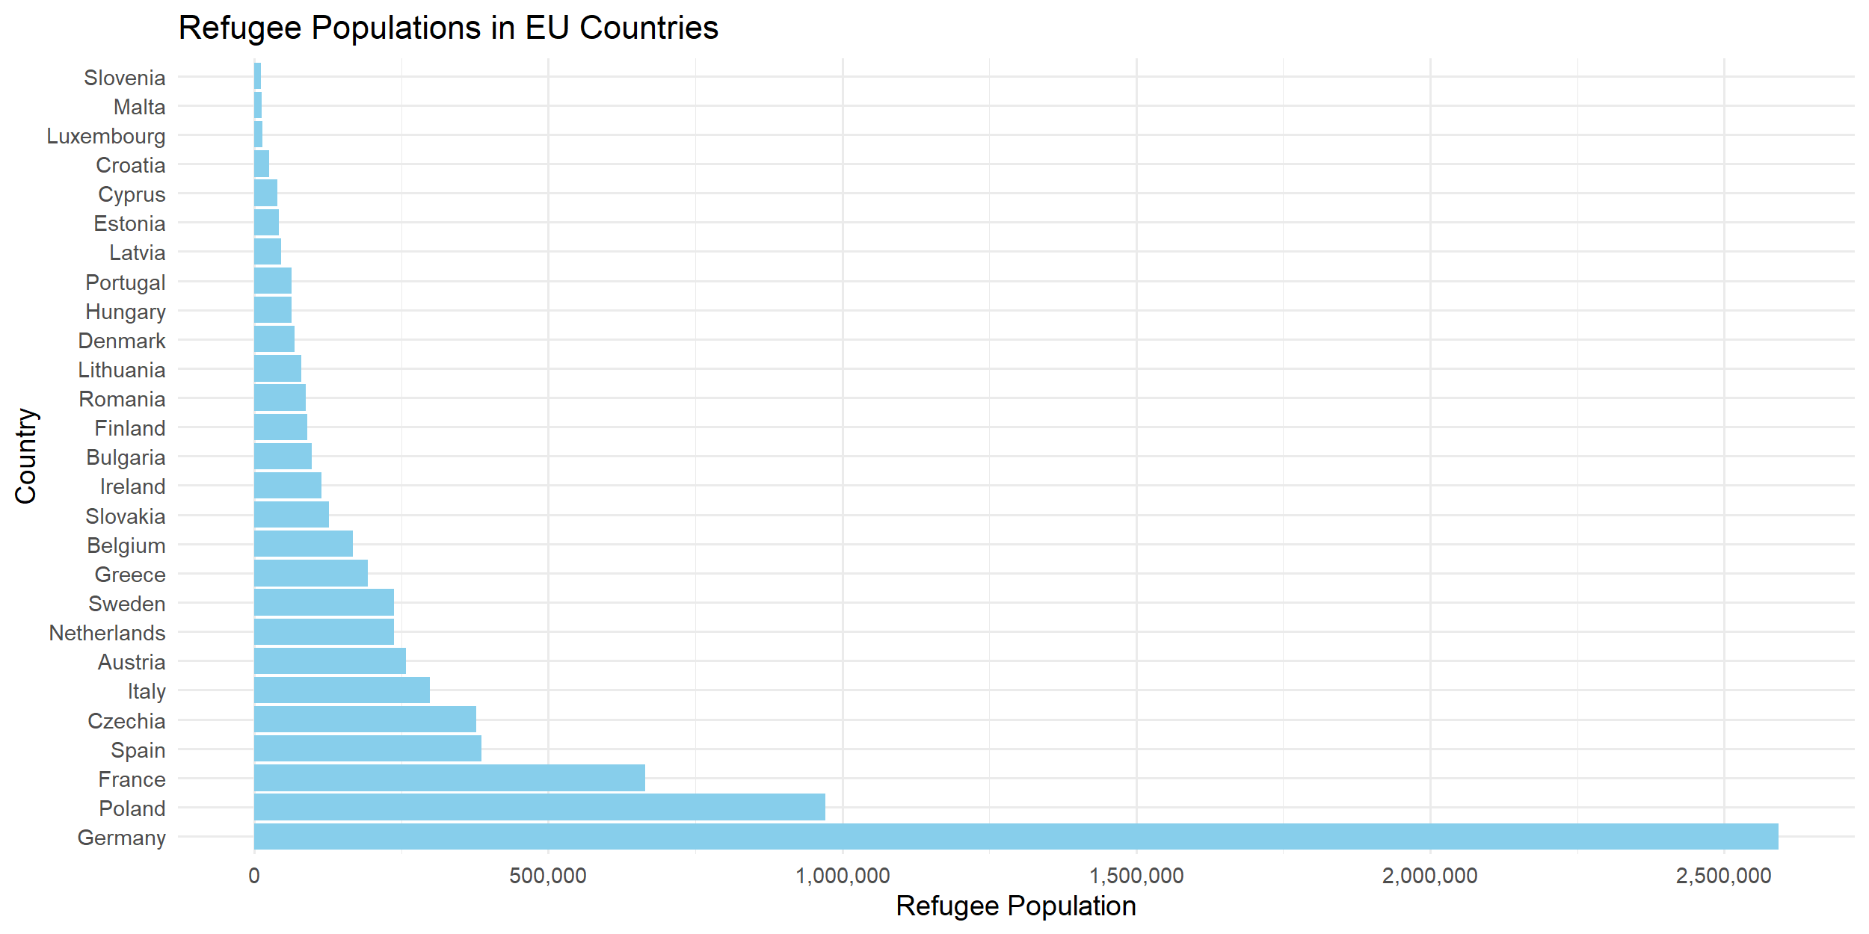
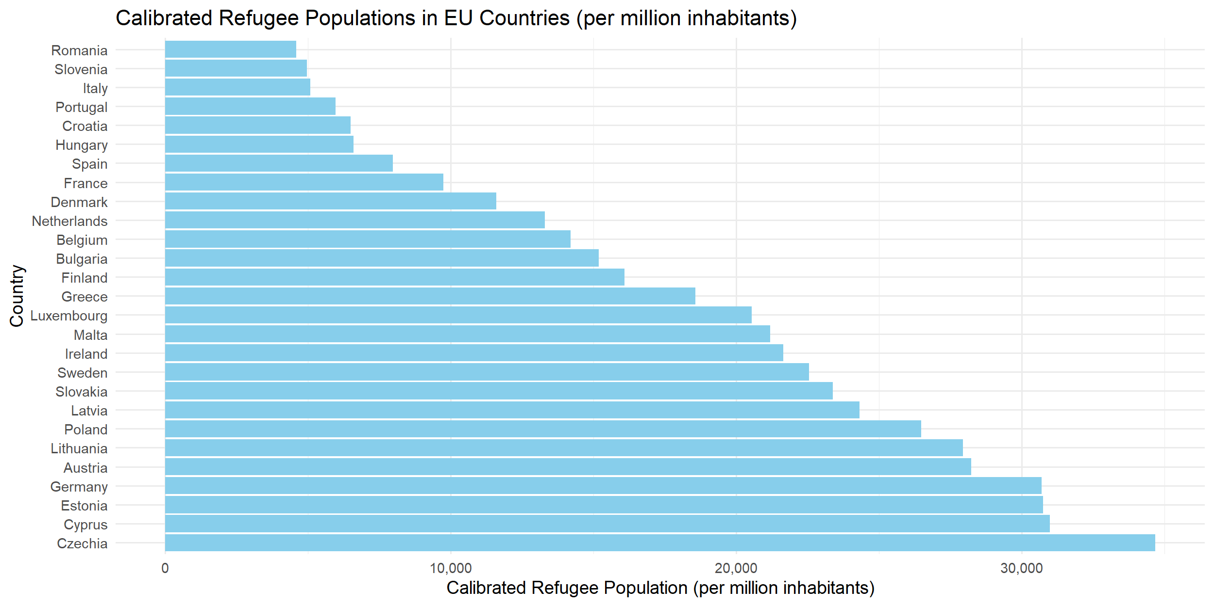
REFUGEE POPULATION DISTRIBUTION

Slide 12
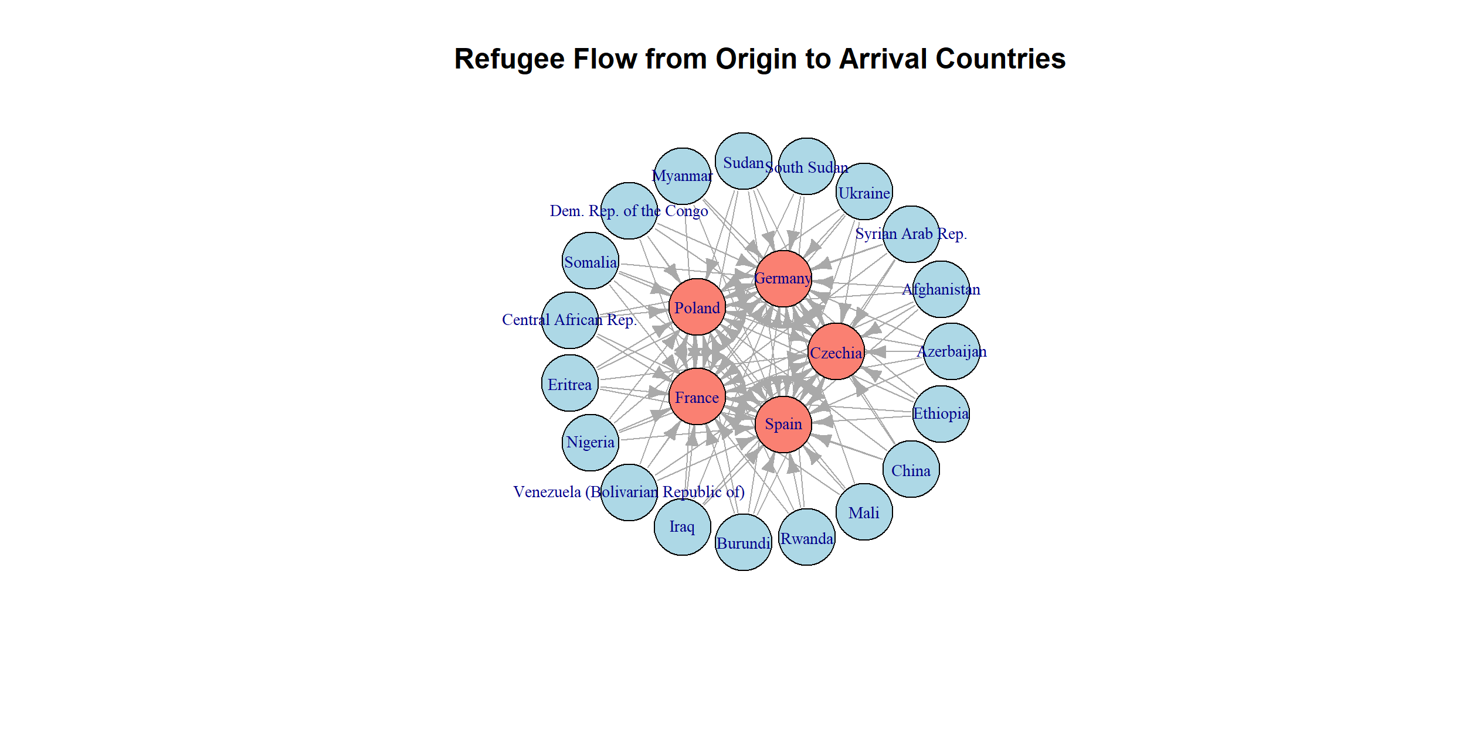
REFUGEE MOVEMENTS FROM OUTSIDE EU

Slide 13
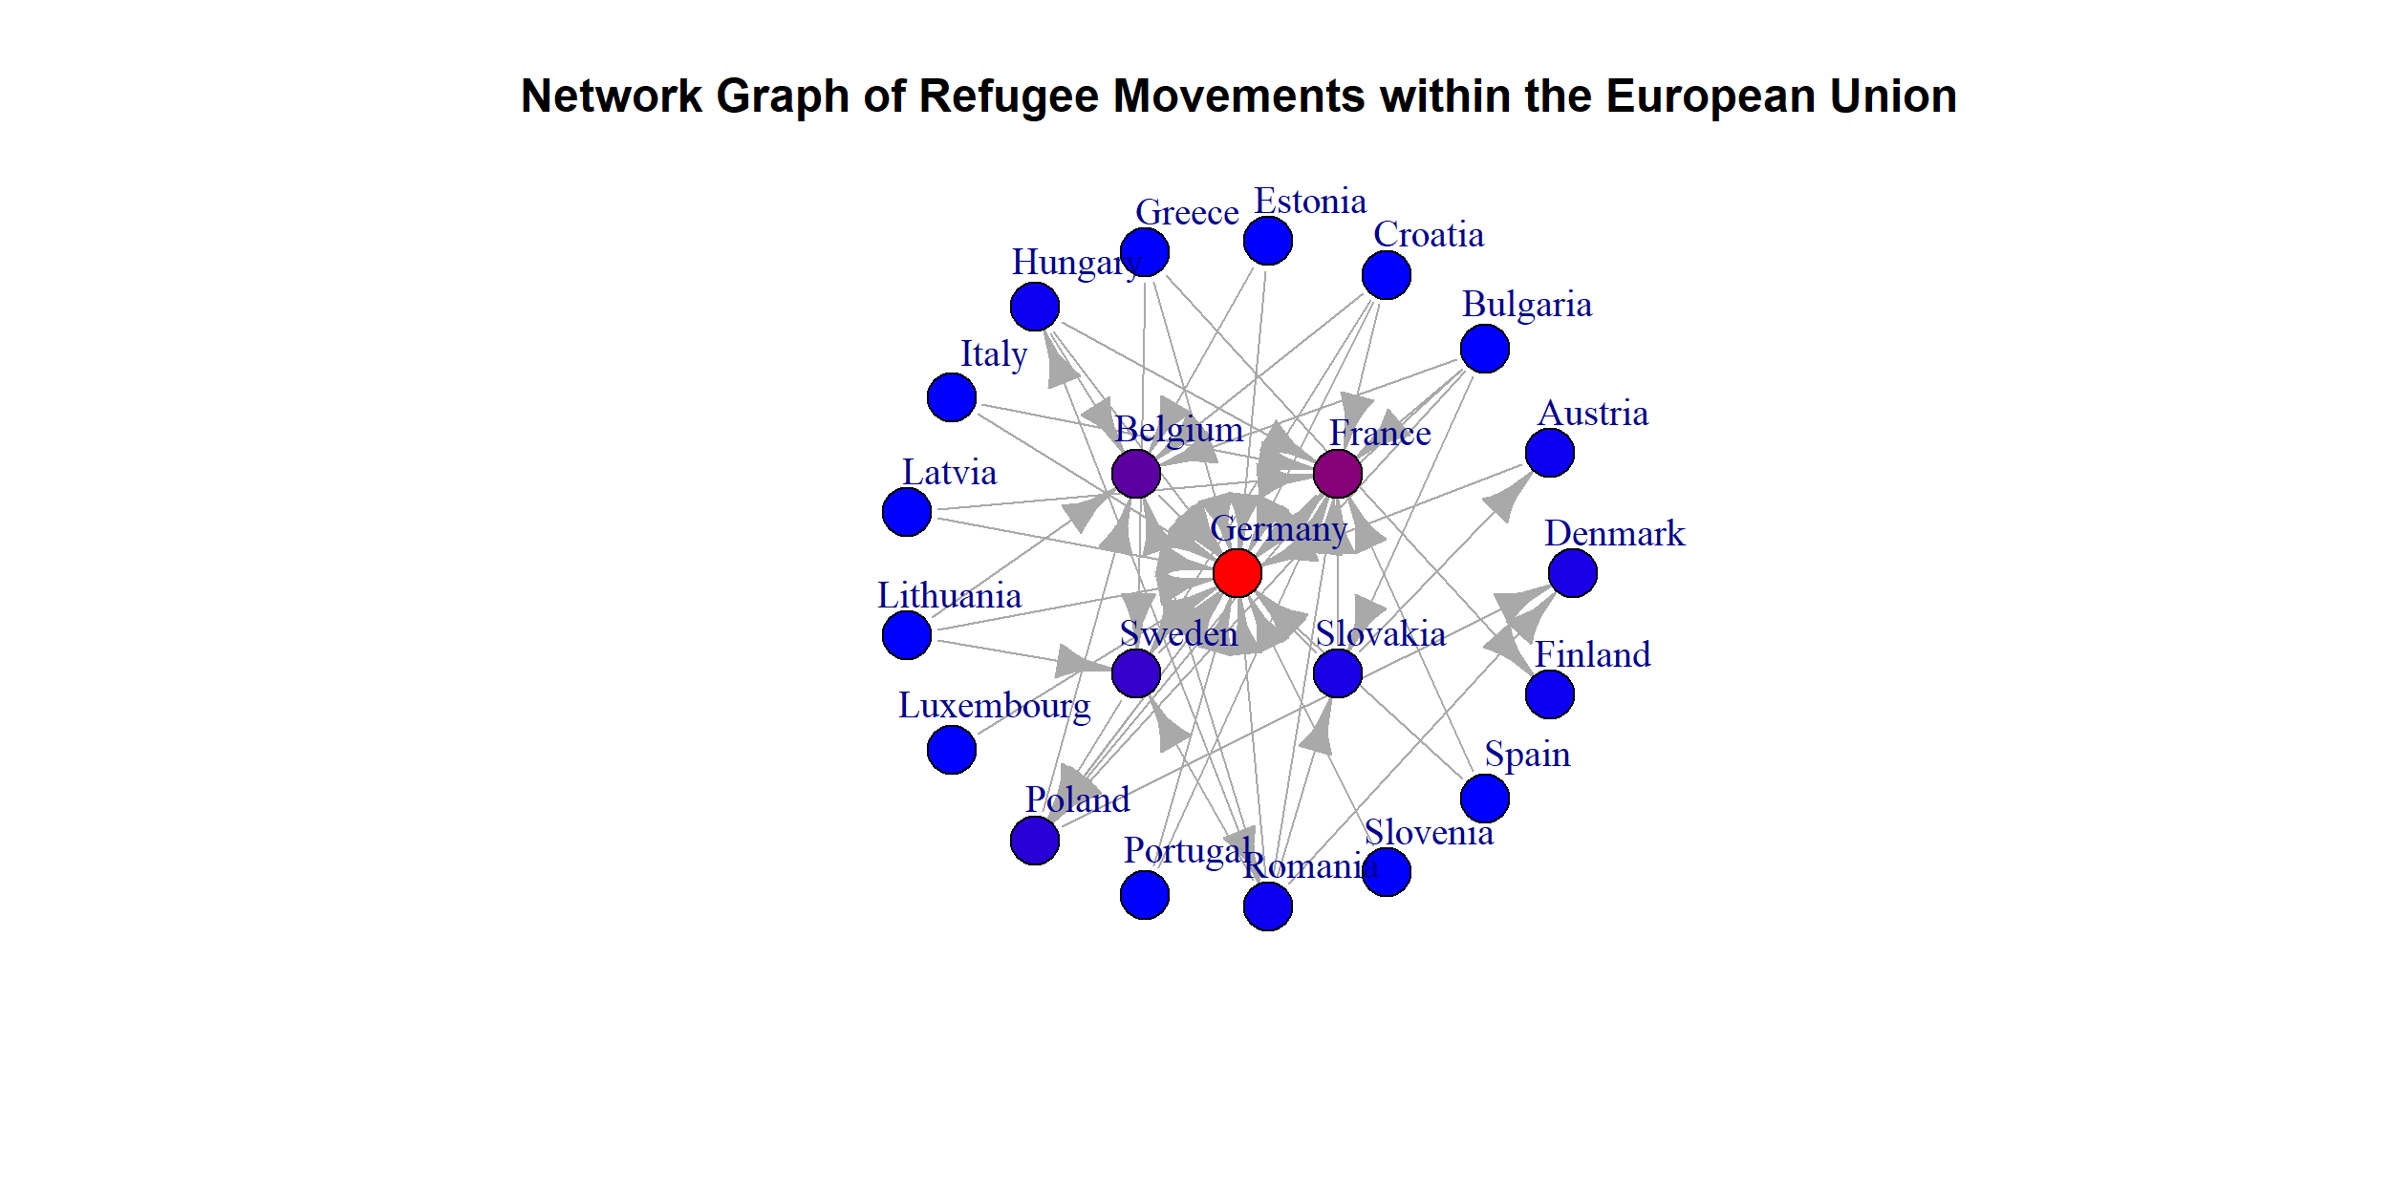
REFUGEE MOVEMENTS INSIDE EU

Slide 14
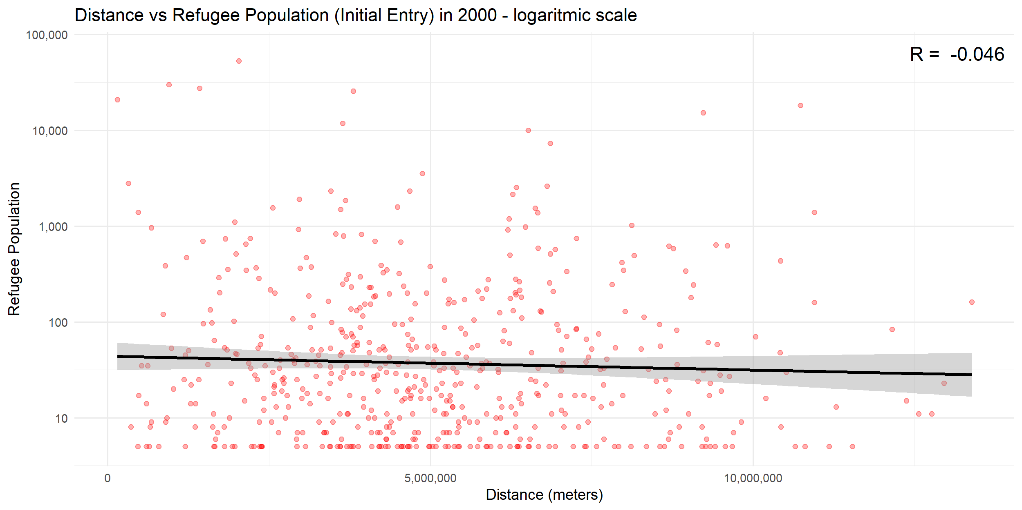
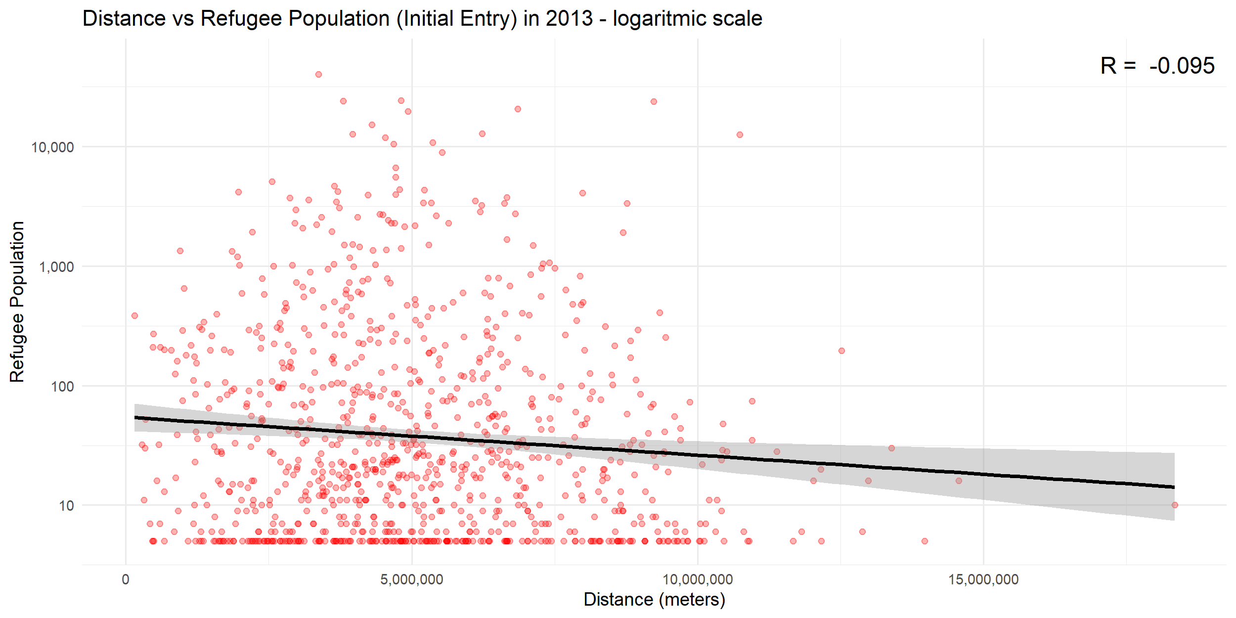
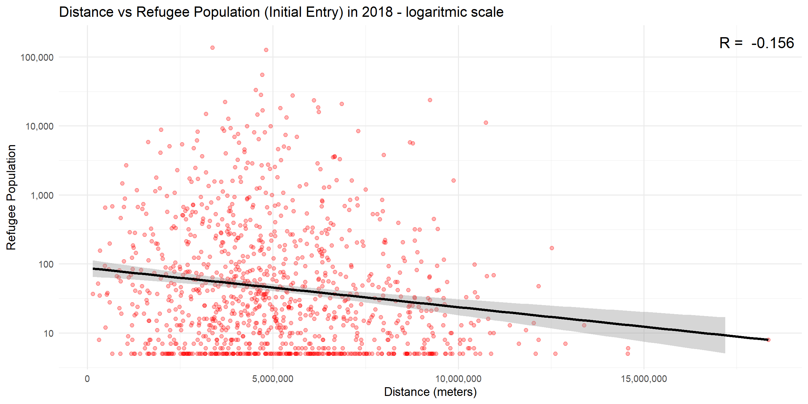
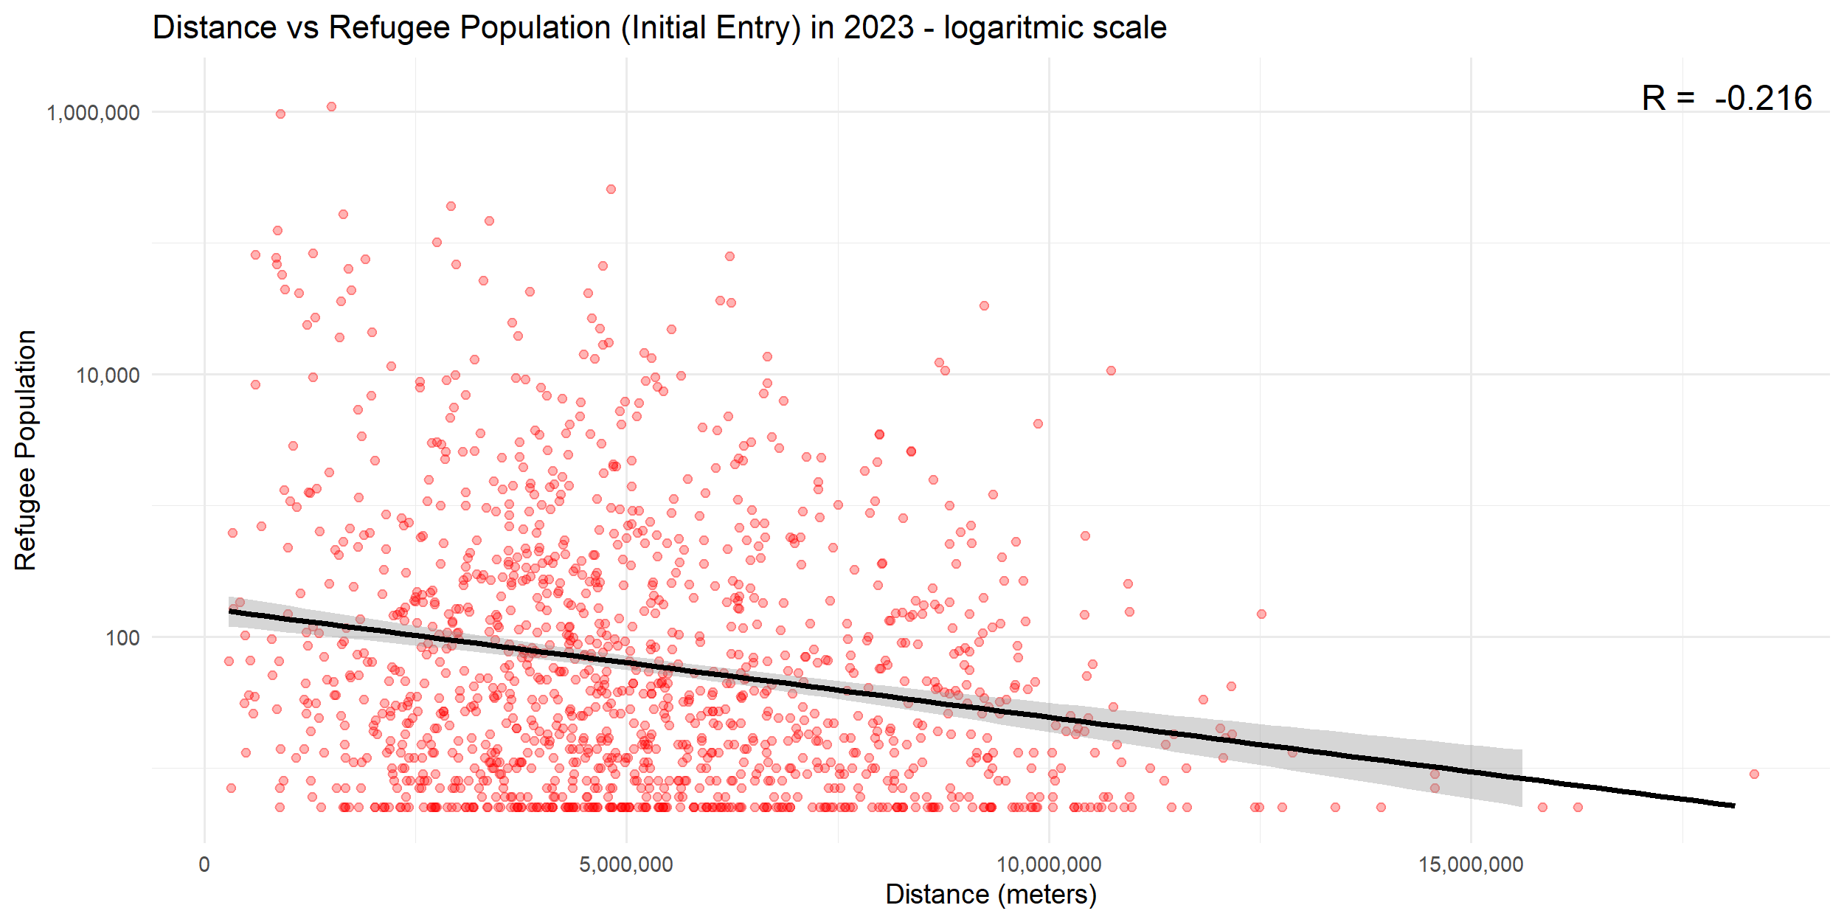
CORRELATION BETWEEN DISTANCE AND REFUGEE POPULATION

Slide 15
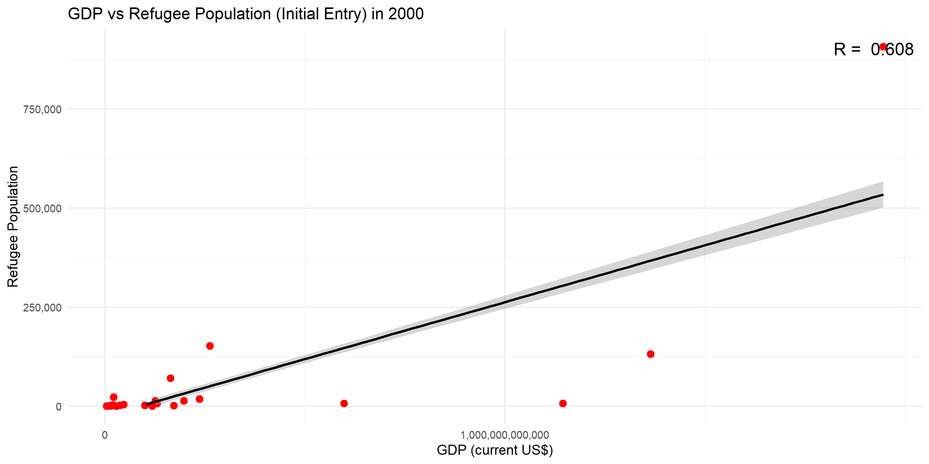
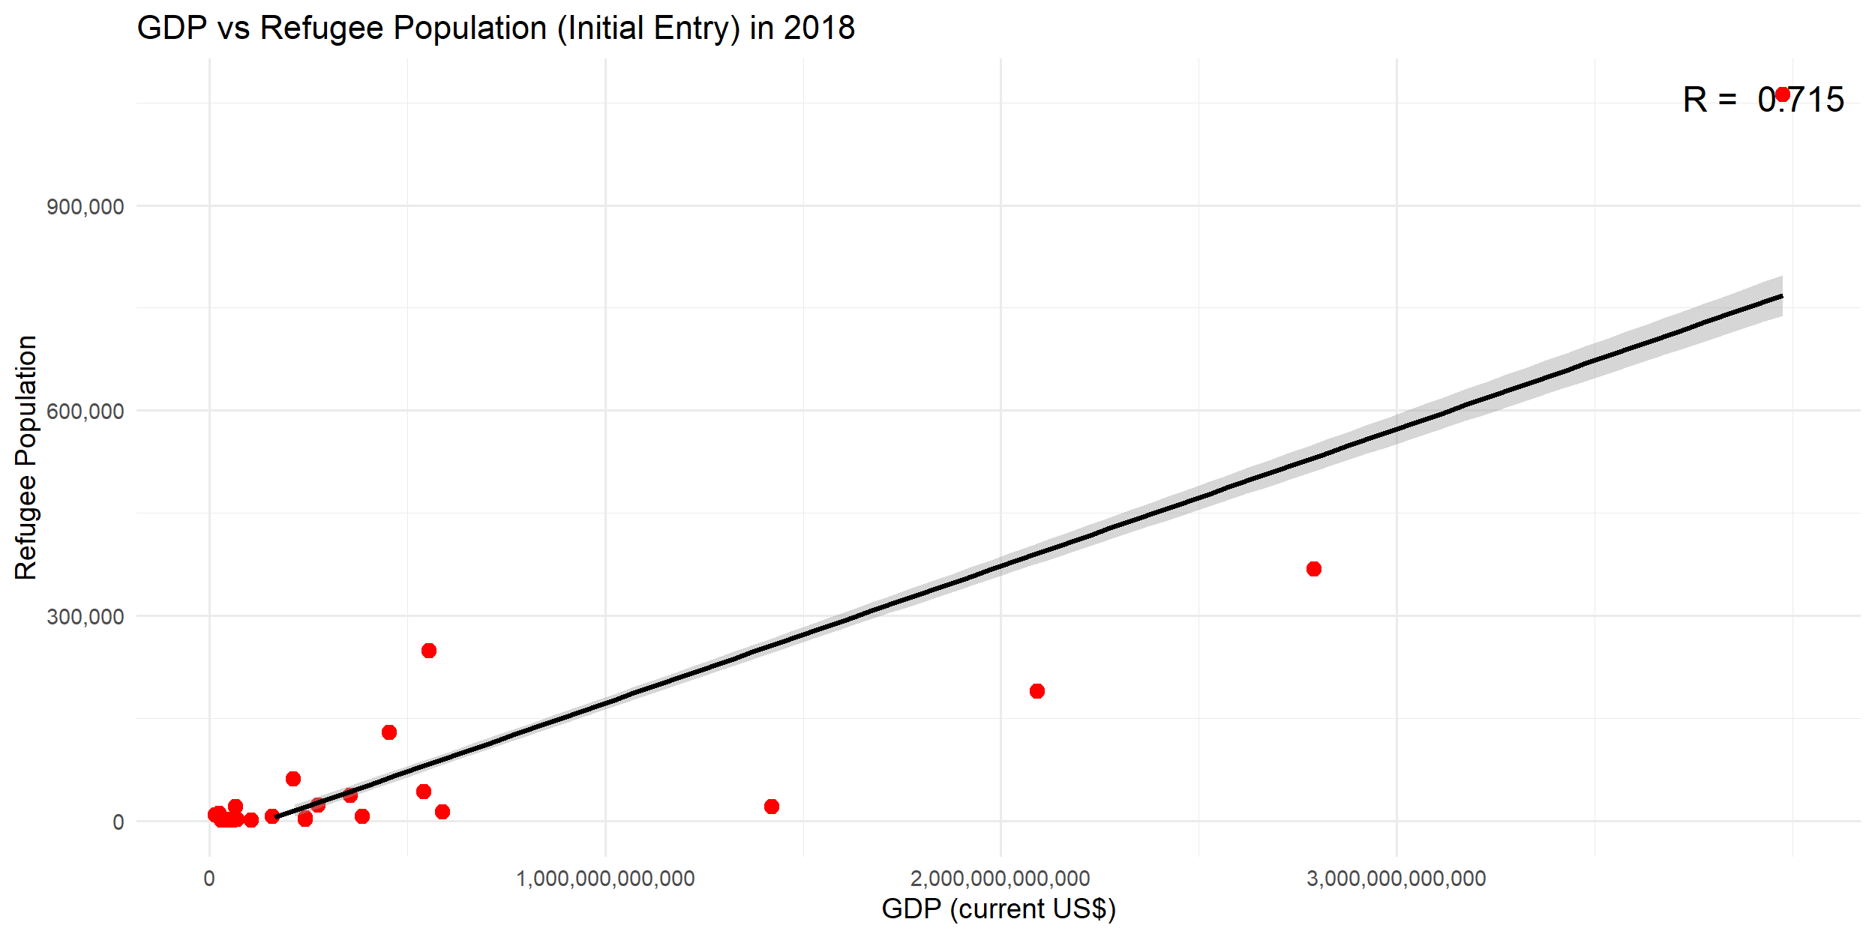
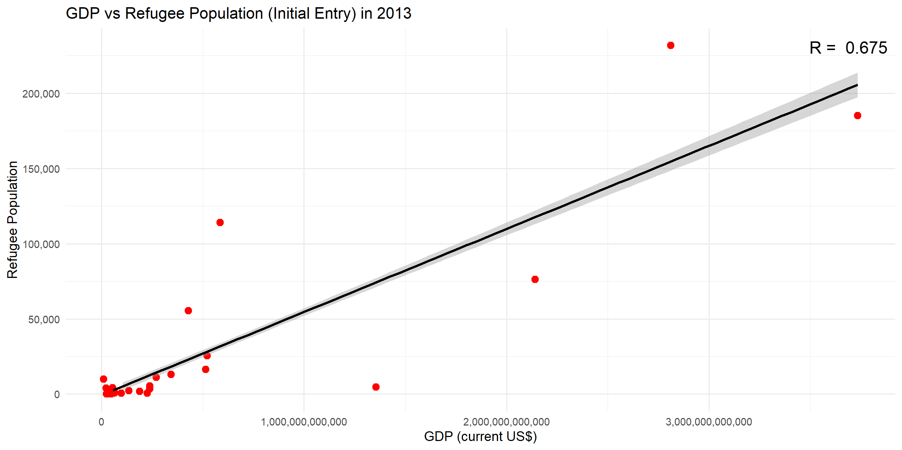
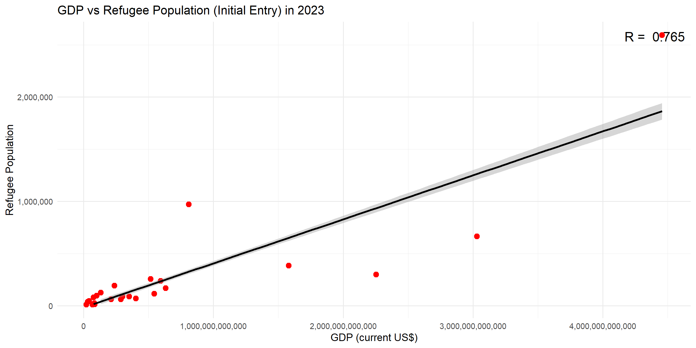
CORRELATION BETWEEN GDP AND REFUGEE POPULATION

Slide 16
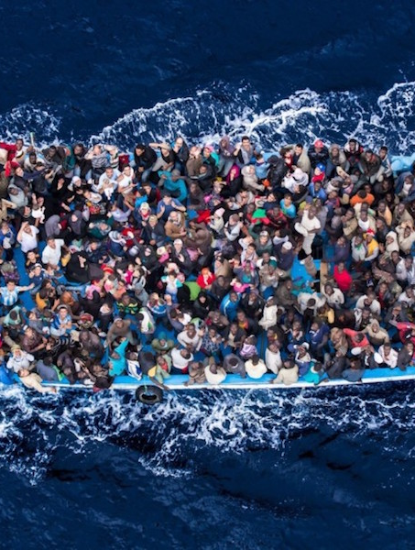
CONCLUSION
In conclusion, the refugee distribution shows a significant concentration in Germany. This trend is primarily influenced by the Ukraine-Russia conflict. Our analysis indicates a positive correlation between proximity and refugee population, leading most Ukrainian refugees to choose Germany. Furthermore, Germany's status as the European Union's largest economy attracts a substantial number of refugees within the EU. Despite this large intake, Germany's population and GDP proves a balanced distribution across EU.

Slide 17
THANK YOU

